Slide 1



6
CRITICAL
THINKING SKILLS
Improving Media Literacy

Slide 2

What are we looking at today?
01
Critical Thinking - What is it?
02
Media Literacy - How to improve
03
Six Critical Thinking Skills
04
Importance of Critical Thinking
05
Applying the skills
06
Check your understanding

Slide 3
Our aim today is to learn about....
The ability to define critical thinking and media literacy
Understanding skills of critical thinkers
Applying critical thinking skills to media and decision-making

Slide 4

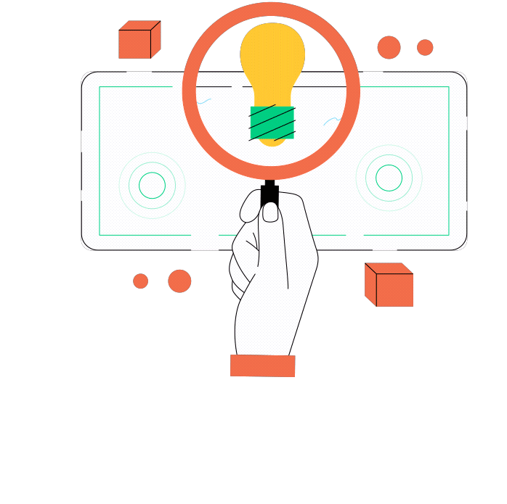
Critical Thinking
Critical thinking is the ability to analyse information objectively and make a judgment or decision. It is purposeful, logical, balanced, and considers all parts of the problem.
Through critical thinking, we achieve an in-depth understanding of the world by being engaged and curious when learning.

Slide 5
Activity:
Pick a topic you are interested in and create a debatable question. For example, are video games bad for you?
Research both sides of the argument, finding at least 2 points for and 2 points against.
Analyse the evidence by asking yourself:
  Is this a fact or an opinion?
  How strong is the evidence?
  Could someone disagree, and why?
Form a conclusion by deciding which side you find stronger - can you explain why?

Slide 6
Media Literacy
To discuss media literacy, we must first define media. Media is any form of communication intended to have reach and influence. Examples include music, art, books, TV shows, movies, news, and social media.
Media literacy is the ability to access, analyze, evaluate, create, and act using all forms of media. It is especially valuable today, when we are engaging with media more than ever before.

Slide 7

6
01
Seek Diverse Perspectives
02
Ask Questions
CRITICAL THINKING
SKILLS
03
Engage in Conversation
04
Self-Reflect
05
Educate Yourself
06
Apply Your Learning

Slide 8
01
Seek Diverse Perspectives
Algorithms on social media platforms feed us information that align with our own views. We must intentionally seek out perspectives that differ from our own. This allows us to see alternative ideas, improves understanding, and creates a more accurate picture of the world we live in.

Slide 9
02
Ask Questions
Be curious about the world and people around you. Questions help us clarify, explore, and evaluate information. Ask yourself: What is the purpose of this post? Does the author back up their claims with reliable evidence? Are there any alternative arguments or explanations?

Slide 10
03
Engage In Conversation
Respectful and constructive dialogue with others can lead to collaboration and an exchange of ideas. Conversations with others help us challenge our assumptions and get feedback to our own questions and opinions.

Slide 11
04
Self-Reflect
We often interpret media through our own lens of personal experiences and beliefs. It is important to examine and evaluate our thoughts and values. Introspection gives us insight into our thinking process.

Slide 12
05
Educate Yourself
We can continually become more knowledgeable. Educating ourselves allows personal growth, increases self-confidence, and enhances curiosity. When we consume media, we should ask ourselves: What can I learn from this? How will I use this information?

Slide 13
06
Apply Your Learning
We are bombarded with media every day, so we need to be mindful of what media we give our time and attention to. When we apply our skills to real-world situations, it allows us to test our understanding of concepts, apply logic, and be creative in our thinking.

Slide 14

Which of the six skills do you think is the most important?
Your Turn
Place the checkmark next to your answer.
Seek Diverse Perspectives
Ask Questions
Engage in Conversation
Self-Reflect
Educate Yourself
Apply Your Learning

Slide 15

Importance of
Critical Thinking
  Increases confidence in our ability to analyze and evaluate information
  Helps us make informed decisions, problem solve, and cope with challenges
  Empowers us to trust the choices and decisions we make
  Aids us in adapting to changes more effectively and positively
  Challenges our own assumptions and the assumptions of those around us
  What would you add to this list?

Slide 16
Let’s apply our
LEARNING

Slide 17
Multiple Choice Question
A. Thinking based on assumptions.
B. Thinking outside the box.
What is critical thinking?
C. Using one source of information to reach a conclusion.
Drag and drop your answer here
D. The ability to analyze information objectively using reliable evidence.

Slide 18
Open Response
Question
If you see a news story on social media, which skills can you use to determine if the information is credible?
Write your response here.

Slide 19

Ask Yourself
1. Do you question the authenticity of information you see on social media? (Place the checkmark next to your answer).
Yes
No
2. Have you ever shared a post or reel that you found out later was misinformation? (Place the checkmark next to your answer).
Yes
No

Slide 20

Conclusion
Critical thinking is valuable when interpreting media, but it can also be beneficial to you in all aspects of life.
Our assumptions, wishful thinking, and self-interests can be barriers to finding and understanding the information we consume. The goal is to broaden our knowledge and find meaning in what we learn.

Slide 21
Answer Key
Multiple Choice Question
A. Thinking based on assumptions.
B. Thinking outside the box.
What is critical thinking?
C. Using one source of information to reach a conclusion.
D. The ability to analyze information objectively using reliable evidence.

Slide 22
Answer Key
Open Response
Question
If you see a news story on social media, which skills can you use to determine if the information is credible?
Sample answer: Seek diverse perspectives to see if multiple credible sources confirm the information. Ask questions to find out more details on the story. Educate yourself by determining the purpose and intent of the story.

